Slide 1
Check-it Before Check-in
Real-time and Big Data
Spring 2015

Slide 2
Analytics Project Presentation - Spring 2015
Analytics Project: Check-it Before Check-in
Team: Rahul Desai
Suruchi Sharma
Nikita Amartya

Slide 3
Check-it Before Check-in
Abstract
Review rating prediction is one of the most challenging text mining problems. Through our analytic, we want to make more specific recommendation for any user based on textual review from similar users, using Hadoop framework.
Analytic
To predict the rating of a restaurant for a given user
The analytic can be extended to allow a restaurant to target specific customers

Slide 4
Check-it Before Check-in
Background
Consumers usually do not make full use of information available on websites and eventually overestimate or underestimate scores compared with the attitudes in review text. This situation often occurs when new users use review systems to make their first judgment.

Slide 5
Check-it Before Check-in
Motivation
Yelp dataset reviews can be used to classify and project the relevance of a user review and make recommendations. Our project aims at analyzing the text of all such reviews and providing recommendations based on reviews by users whose overall taste is similar to the given user’s.
Who will benefit from this analytic?
Customers, Business owners

Slide 6
Check-it Before Check-in
Why is this analytic important?
Applying sentiment analysis, extracting attitude from review texts and making prediction on rating score, we can :
Give suggestions to users and help them make correct score assignment
Reduce bias of recommendation system based on the prediction of review score.
Advertise to targeted group of users.

Slide 7
Check-it Before Check-in
Data Sources
Name: Yelp Dataset Challenge
Description: http://www.yelp.com/dataset_challenge
It consists of 6,304,123 reviews, 159,030 business attributes and 366,716 users. This data is in JSON format. The dataset contains following information:
Business: Business Name, Id, Category, Location, etc.
User: Name, Id, Review Count, Friends, Votes, etc.
Review: Date, Business, Id, Stars, Text, etc.
However, we have focused only on restaurant reviews which contains ~22,000 entries and amounts to around 1GB of data.

Slide 8
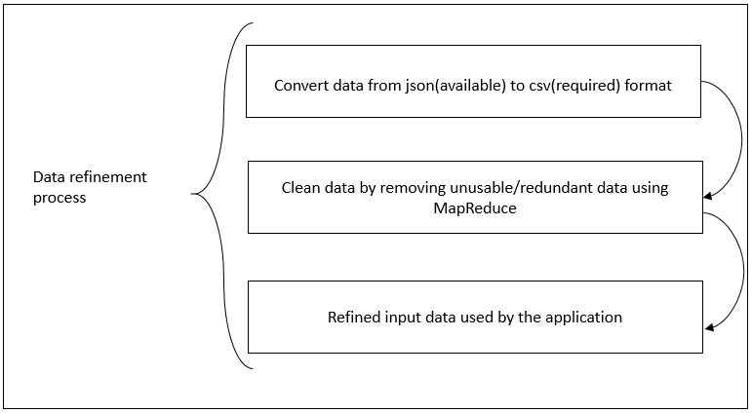
Check-it Before Check-in
Design Diagram
Convert data from json to pipe delimited format

Slide 9
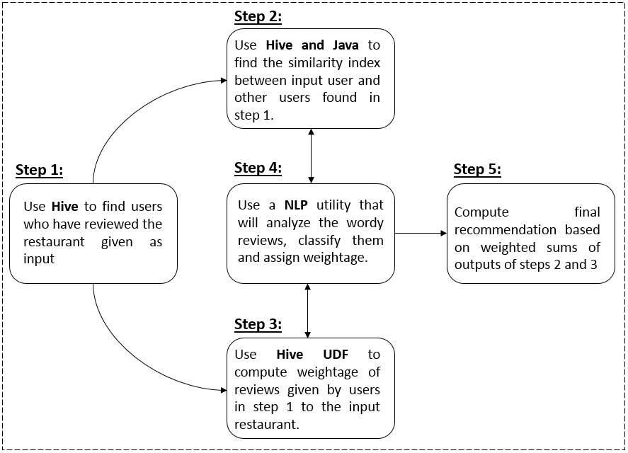
Check-it Before Check-in
Design Diagram
Platform(s) on which the analytic ran:
Cloudera Quickstart VM

Slide 10
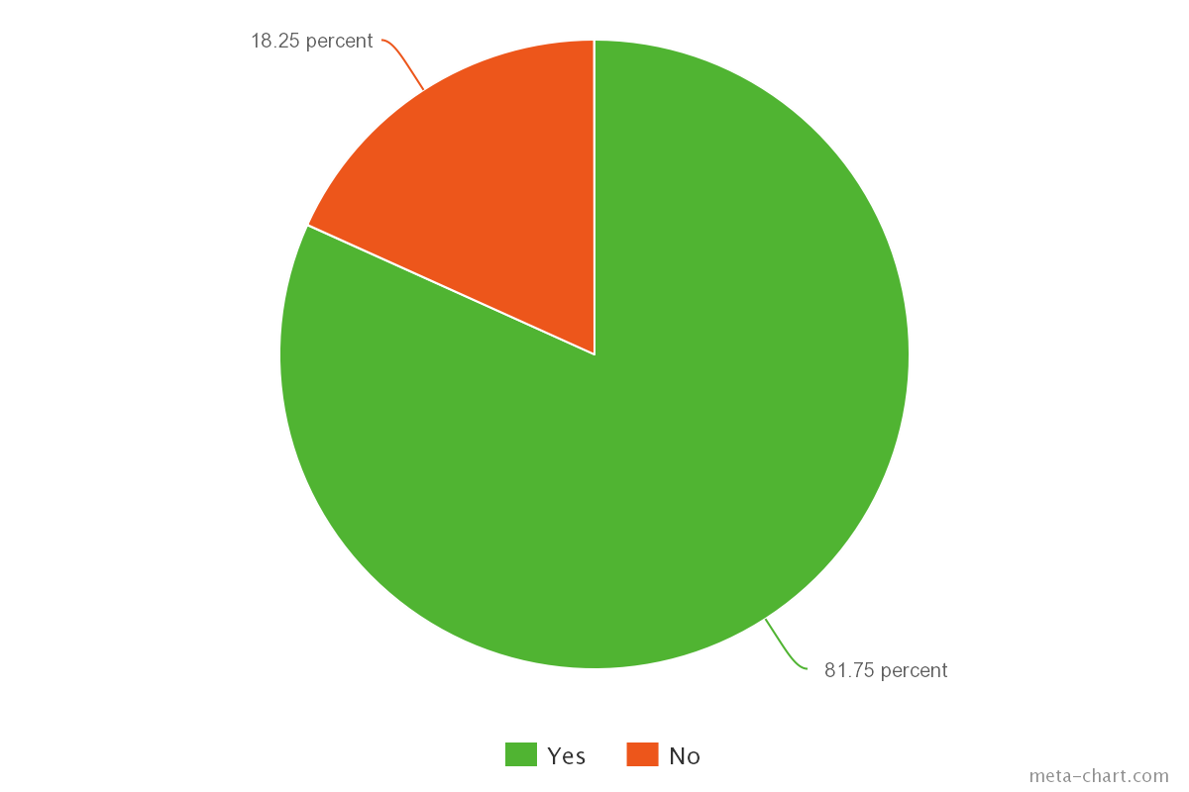
Check-it Before Check-in
Results
Result 1:
User: Brad
Business: Mon Ami Gabi
Recommendation: 81.75 %

Slide 11
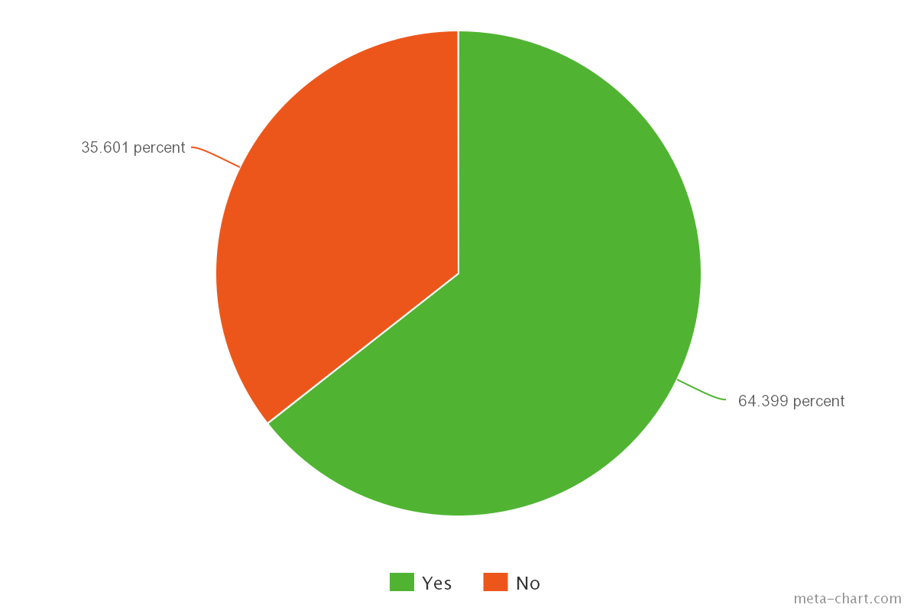
Check-it Before Check-in
Results
Result 2:
User: Westie
Business: Serendipity
Recommendation: 64.399 %

Slide 12
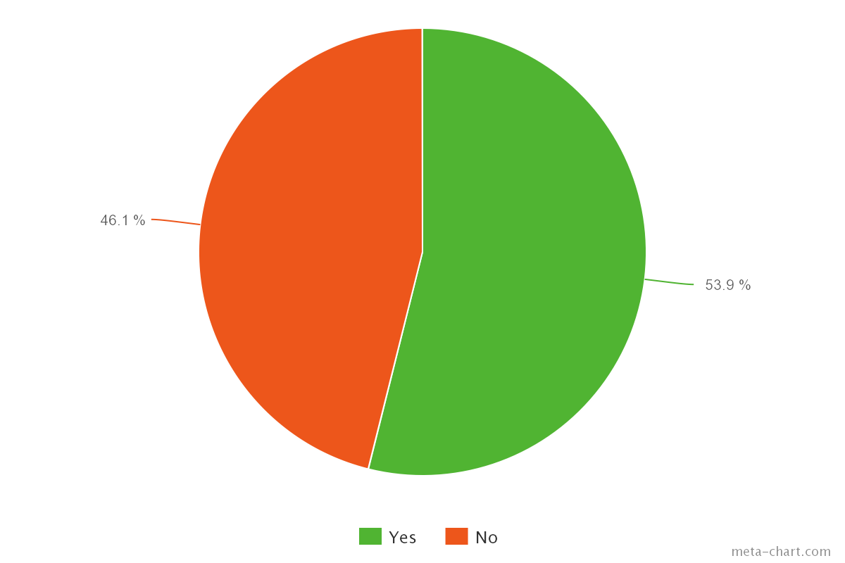
Check-it Before Check-in
Results
Result 3:
User: Jennifer
Business: Arriba Mexican Grill
Recommendation: 53.90%

Slide 13
Check-it Before Check-in
Obstacles
Obstacle 1: Sentiment analysis of reviews (Used Natural Language Processing techniques)
Obstacle 2: Running resource intensive queries leading to VM (Virtual Machine) crash (Performance tuning by avoiding unnecessary joins and using a system with better hardware resources)

Slide 14
Check-it Before Check-in
Conclusion
Users:
We can run this analytic to predict whether a user will like a restaurant or not. Rather than just relying on star ratings or reading through several textual reviews, this recommendation system can be used to get an overall idea about the likelihood of a user liking a business.
Businesses:
A business can advertise itself to a set of users who are more likely to like the restaurant.
We can run this analytic for all the users from the area where a business is located and if the prediction is in favor of the business for a user, that user is our target customer. More positive reviews means more revenue.

Slide 15
Check-it Before Check-in
Acknowledgements
Prof. Suzanne Macintosh for her guidance and support during the course of this project
Amazon for AWS voucher for this work.
Yelp.com for putting up their extensive data sets for free online.

Slide 16
Check-it Before Check-in
References
[1] Hive - A Warehousing Solution Over a Map-Reduce Framework Authors: Ashish Thusoo, Joydeep Sen Sarma, Namit Jain, Zheng Shao, Prasad Chakka, Suresh Anthony, Hao Liu, Pete Wyckoff and Raghotham Murthy from Facebook Data Infrastructure Team
[2] Amazon.com recommendations : Item-to-Item Collaborative Filtering by Greg Linden, Brent Smith, and Jeremy York
[3] S. Vinodhini, V. Rajalakshmi, B. Govindarajulu: Building Personalised Recommendation System With Big Data and Hadoop Mapreduce
[4] T. White. Hadoop: The Definitive Guide. O’Reilly Media Inc., Sebastopol, CA, May 2012.
[5] J. Dean and S. Ghemawat. MapReduce: Simplified data processing on large clusters. In proceedings of 6th Symposium on Operating Systems Design and Implemenation, 2004.

Slide 17
Check-it Before Check-in
Thank you!!

